Slide 1
CAR DHEKO
Used Car Price Prediction

Slide 2
Objective:
The goal of this project is to develop an accurate and user-friendly car price prediction model for CarDekho using historical data on used car prices.
The model will be integrated into a Streamlit-based web application to provide real-time price estimates based on user-inputted car features.
This tool will enhance customer experience and streamline the pricing process for sales representatives.

Slide 3
Business Problem:
Buying or selling a used car can be challenging due to inconsistent pricing and a lack of market insights. An accurate car price prediction model will provide users with a fair market estimate, improving customer satisfaction and helping sales representatives make data-driven decisions.
Key Stakeholders:
Customers – To get fair price estimates for buying/selling cars

Slide 4
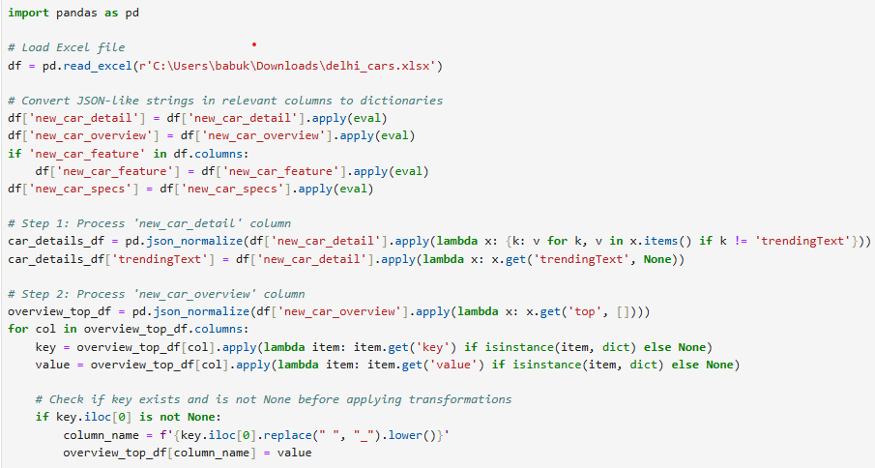
Data Preprocessing:
That's a solid extraction pipeline! Since you've processed the data from six cities, you can now concatenate them into a single dataset for model training. After merging, you might want to:
This script processes car-related data stored in an Excel file, specifically handling JSON-like columns by normalizing and restructuring them into a cleaner tabular format. The final processed data is saved as a new Excel file.
The columns (new_car_detail, new_car_overview, new_car_feature, new_car_specs) contain JSON-like string data.

Slide 5
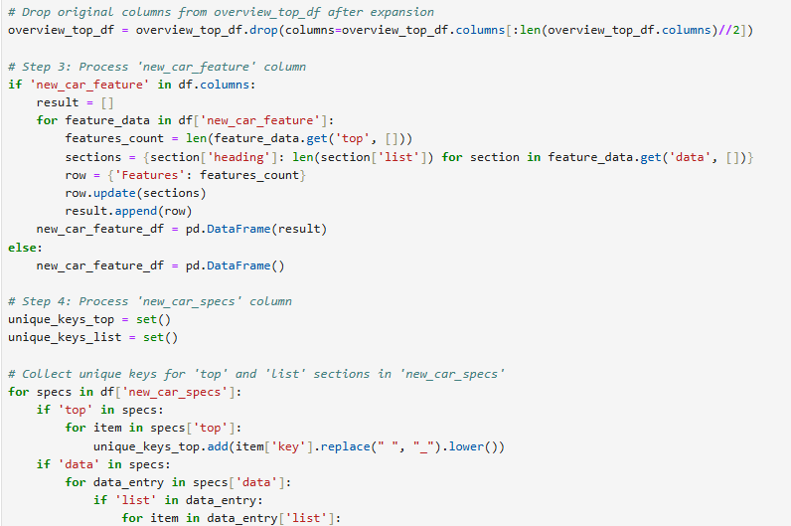
eval() converts these string representations into Python dictionaries.
Extracts all key-value pairs except 'trendingText'.
'trendingText' is extracted separately to preserve it in the final dataset.
Extracts top overview details from new_car_overview.
For each column:
Extracts keys (feature names).
Extracts values (feature values).
Creates new columns with meaningful names.

Slide 6
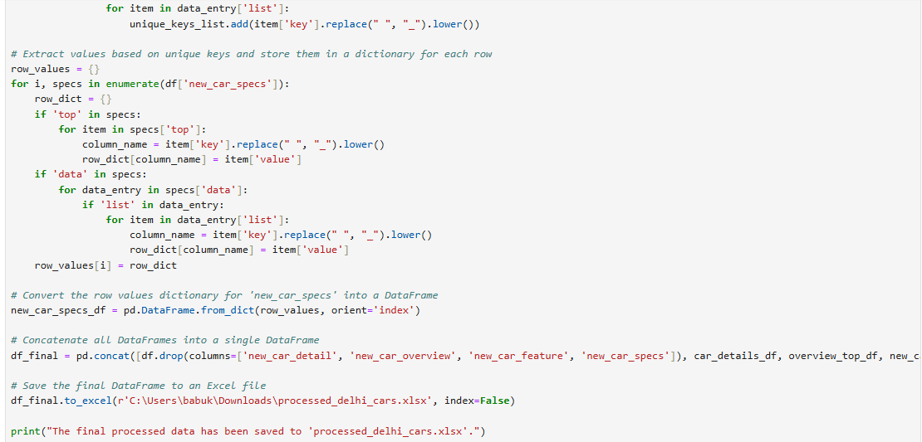
Removes the original dictionary-format columns after expansion.
Extracts:
Feature count from the top section.
Number of items per section from data.
Creates a new DataFrame new_car_feature_df to store these values.
Collects all unique keys from:
top section.
list section inside data.
Extracts values row by row based on previously identified keys.
Removes original JSON-like columns from the dataset.
Merges the processed data into df_final.

Slide 7
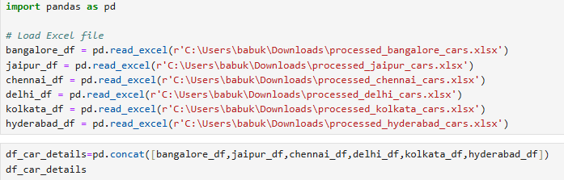
Data Processing:
Read csv files for the 6 cities.
Concat the dataset into a single dataset to process it.

Slide 8
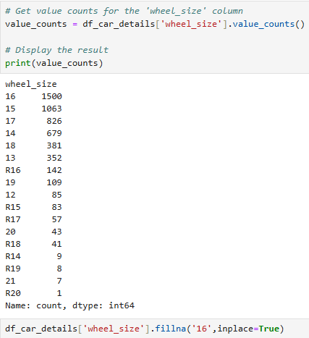
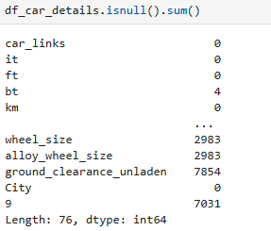
Handle Missing Values:
Find the missing values in the each column.
Get the value count of each missing value column and replace with the most frequent values.

Slide 9
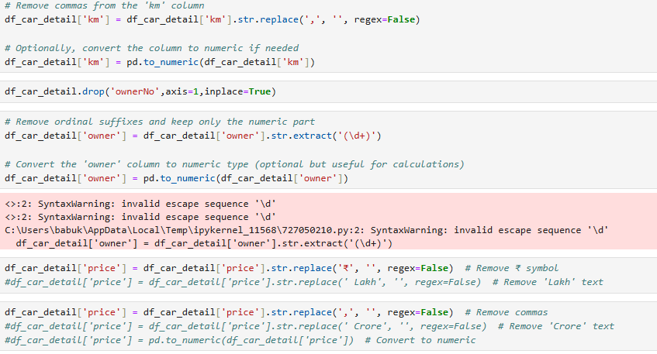
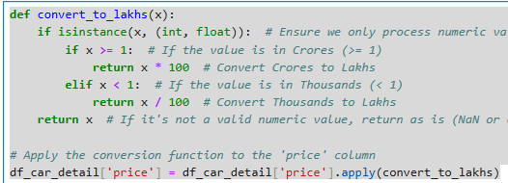
In km column remove the comma.
In Price Column Removes commas (',') → Ensures numbers are properly formatted.
Removes 'Crore' and 'Lakh' → Standardizes price values.
Convert Crores into Lakhs.

Slide 10
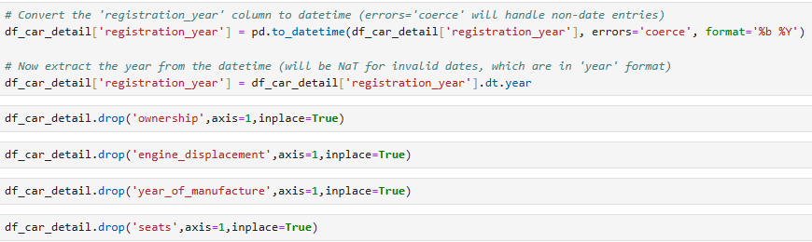
In registration column take only the year of the car registered.
Remove the columns where it is already exist in the dataset.

Slide 11
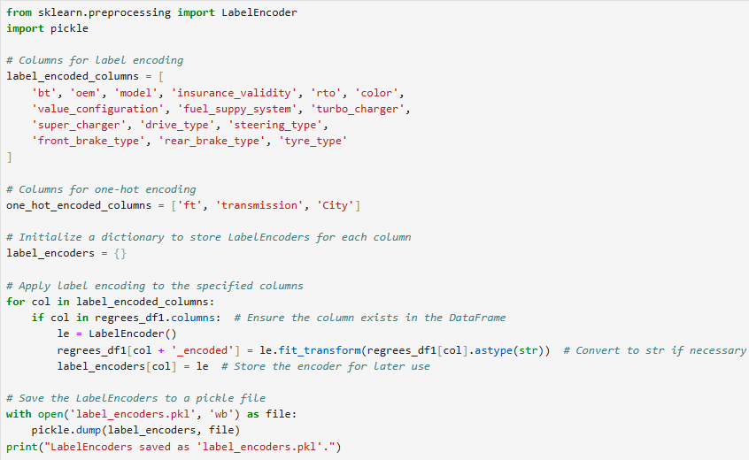
Categorial Encoding:
Encoded the Categorial variables.
Label Encoding
One Hot encoding

Slide 12
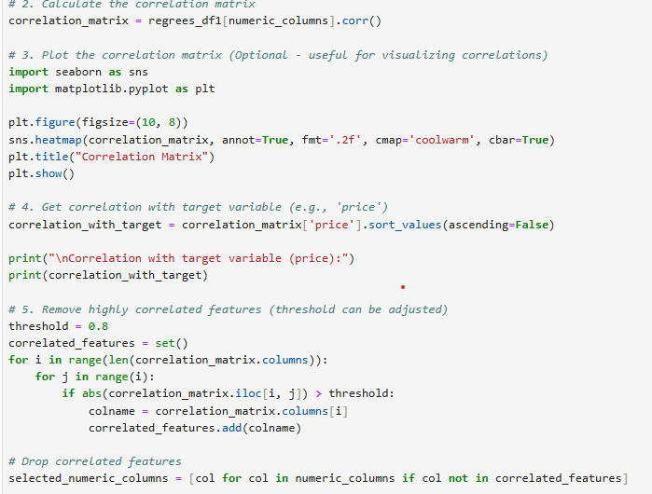
Visualization:
Finds how strongly each feature correlates with the target variable 'price'.
Sorts in descending order to see the most important features first.
Defines a correlation threshold of 0.8 (can be adjusted).
Loops through the correlation matrix:
If two features are highly correlated (above 0.8), one is removed to avoid redundancy.
Stores the redundant feature names in correlated_features.
Creates a filtered list of numeric columns after dropping correlated ones.
Only keeps features that contribute unique information.
Creates a refined DataFrame with only important, non-redundant numeric features.
This improves model efficiency by removing unnecessary variables.

Slide 13
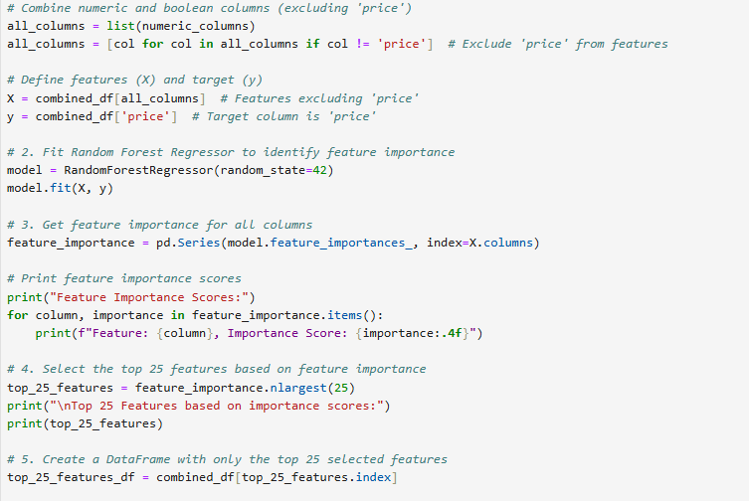
Feature Selection
Creates a list of all numeric columns except the target variable ('price').
X → Feature matrix (all numeric columns except 'price').
y → Target variable (price prediction).
Trains a Random Forest Regressor on the dataset.
Random Forest is useful for:
Handling non-linear relationships.
Measuring feature importance.
Handling large datasets efficiently.
Extracts feature importance values from the trained model.
Higher values mean the feature has a stronger impact on 'price'.
Filters the original dataset to retain only the top 25 features.

Slide 14
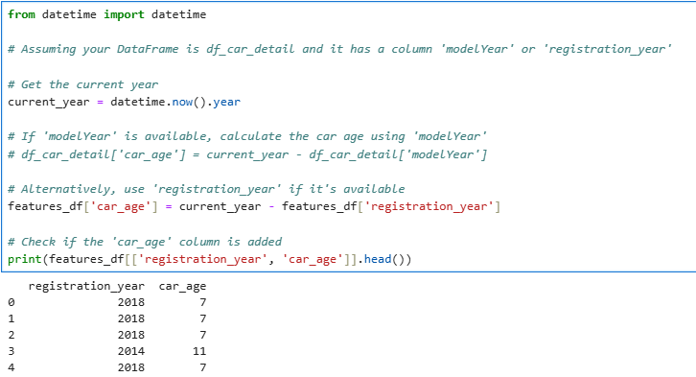
New Feature:
Retrieves the current year dynamically using datetime.now().year.
Ensures that the calculation remains up to date each year.
Subtracts the car’s registration year from the current year to compute the car's age.
The 'car_age' column helps in price prediction, as older cars generally have lower resale values.

Slide 15
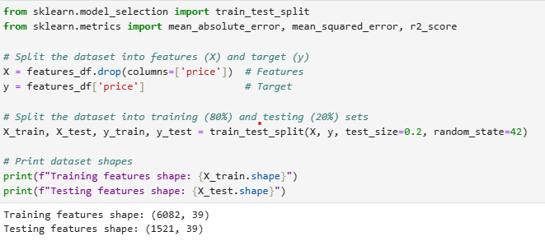
Data Splitting:
splits the dataset into training and testing sets, which is essential for building and evaluating a machine learning model for car price prediction.
train_test_split: Splits the dataset into training and testing sets.
test_size=0.2: Allocates 80% for training and 20% for testing.
random_state=42: Ensures reproducibility (same split each time the code runs).

Slide 16
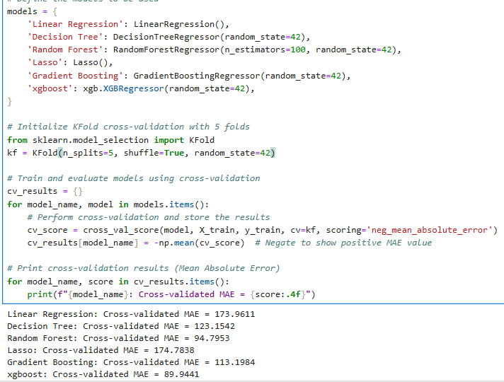
Model Training:
A dictionary of different regression models for training.
Includes:
Linear Regression: A simple regression model.
Decision Tree: A tree-based regression model.
Random Forest: An ensemble method combining multiple trees.
Lasso Regression: A linear model with L1 regularization.
Gradient Boosting: A boosting algorithm improving weak learners.
XGBoost: An optimized boosting algorithm.

Slide 17
Splits data into 5 folds for training and validation.
shuffle=True: Ensures data is randomly shuffled before splitting.
random_state=42: Ensures consistency in splits.
Iterates over each model and trains using 5-fold cross-validation.
Mean Absolute Error (MAE) is used as the evaluation metric.
cross_val_score returns negative MAE (because scikit-learn minimizes loss), so we negate it to get the actual MAE.

Slide 18
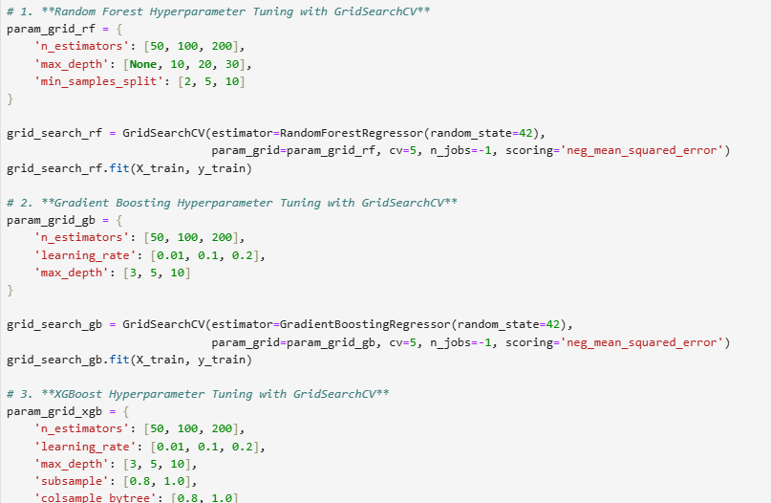
Hyperparameter Tuning:
Each model is optimized using GridSearchCV, which systematically tests multiple hyperparameter combinations to find the best configuration.
n_estimators: Number of trees in the forest.
max_depth: Maximum depth of the trees.
min_samples_split: Minimum number of samples required to split a node.
learning_rate: Step size shrinkage for updating weights.
n_estimators: Number of boosting stages.
max_depth: Maximum depth of the trees.
subsample: Fraction of samples used for training.
colsample_bytree: Fraction of features used per tree.

Slide 19
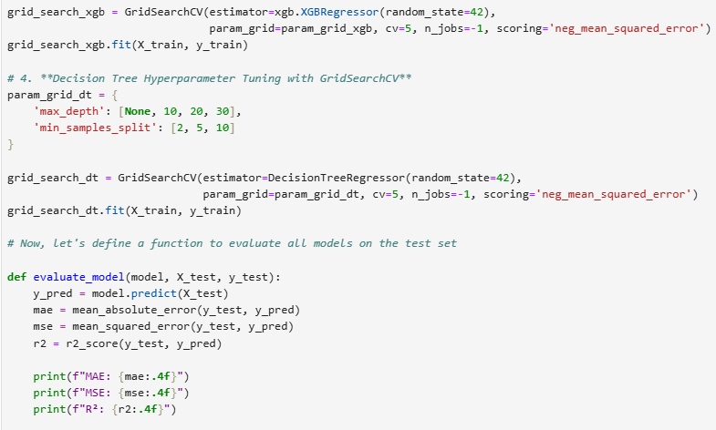
MAE (Mean Absolute Error): Measures absolute differences between predictions and actual values.
MSE (Mean Squared Error): Penalizes large errors more.
R² Score: Measures how well the model explains variance in the data (closer to 1 is better).

Slide 20
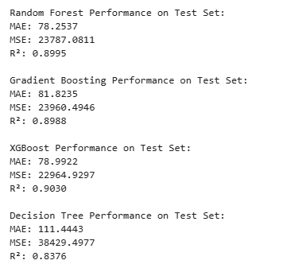
XGBoost performed the best overall with:
Lowest MSE (22,964.93) → Most accurate predictions
Highest R² (0.9030) → Explains 90.3% of variance in the data
Low MAE (78.99) → Minimal average prediction error.
Random Forest was a close second, slightly behind XGBoost.
Gradient Boosting had similar performance but lagged behind both XGBoost and Random Forest.
❌ Decision Tree performed the worst:
Highest MAE (111.44) → Largest average prediction error.
Lowest R² (0.8376) → Explains only 83.76% of variance.

Slide 21
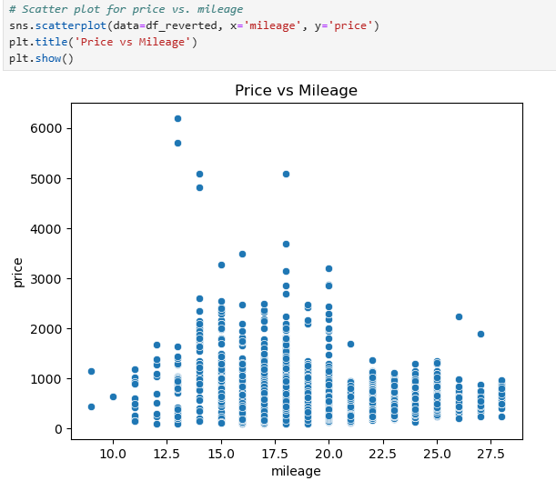
The price appears highest around 15-18 km/l mileage.
Prices decrease for both very low (below 12 km/l) and very high (above 22 km/l) mileage.
There are outliers—some cars with extremely high prices compared to others with similar mileage.
Higher mileage typically suggests better fuel efficiency, but extremely high mileage might indicate older or overused cars, reducing price
Luxury cars often have lower mileage but higher prices, explaining the high-price outliers at low mileage.
Mid-range mileage (15-18 km/l) might belong to well-maintained, fuel-efficient cars, which fetch better prices.

Slide 22
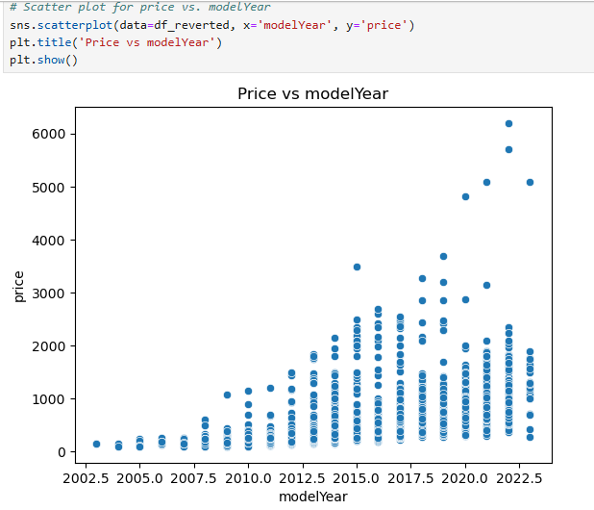
Newer model years tend to have higher prices, showing a clear upward trend.
Cars from older model years (2002-2012) have significantly lower prices.
There are a few outliers, where some older cars have high prices, possibly luxury or vintage models.
The price variance increases for newer models (more spread), suggesting premium features, brand value, or demand differences.
Depreciation effect: Older cars lose value over time.
High variation in newer cars: Some models hold their value better than others.
Luxury models: Some old models still maintain high prices (possible classic or premium cars).

Slide 23
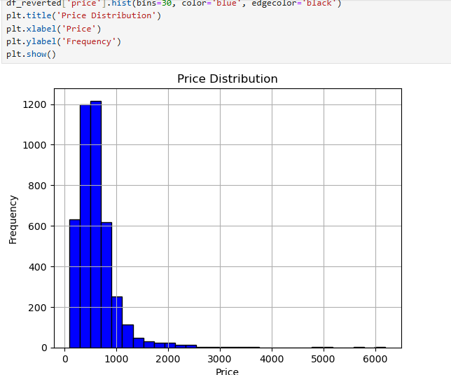
The distribution is right-skewed (positively skewed).
Most car prices are below 1000.
There are a few high-priced cars (outliers), extending beyond 6000.
The majority of cars are priced between 0 and 1000, with the highest frequency around 500-700.
Used car market trend: Most cars in the dataset are low to mid-priced.
Presence of luxury cars: A few cars are priced much higher, possibly luxury models or brand-new vehicles.
Skewness impact: If you’re using regression models, you might need to apply a log transformation on the price variable to normalize the distribution.

Slide 24
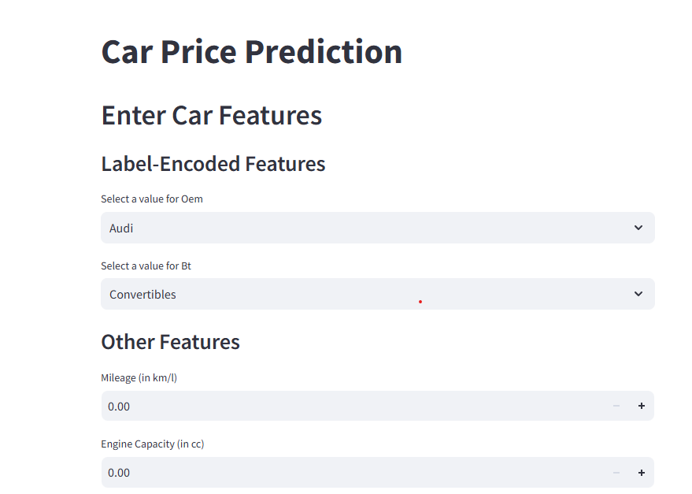
STREAMLIT APPLICATION:
Load the model.
Load the encoding pickle.
Predict the price of the used car.

